Slide 1
TAXES VITA
REAL ESTATE vs IRA/STRS
IRS
Christine Kloezeman, CFE
Accounting Department Coordinator
Professor of Accounting

Slide 2

Quote on
Ronald Reagan’s desk
“There is no limit to what a man can do or where he can go if he doesn’t mind who gets the credit.”
Notes:
Ronald Reagan was my favorite president because he could see both sides of the political issues– he had been a democrat and changed his political ideas to become a republician. Much like myself growing up in a strong democratic home and later changing my political beliefs.

Slide 3

Book of Mormon Quote
... and the priest, not esteeming himself above his hearers, for the preacher was no better than the hearer, neither the teacher any better than the learner; and thus they were all equal. Alma 1:26
Notes:
The other quote is from my religion. I hope to never stop learning from my students.

Slide 4
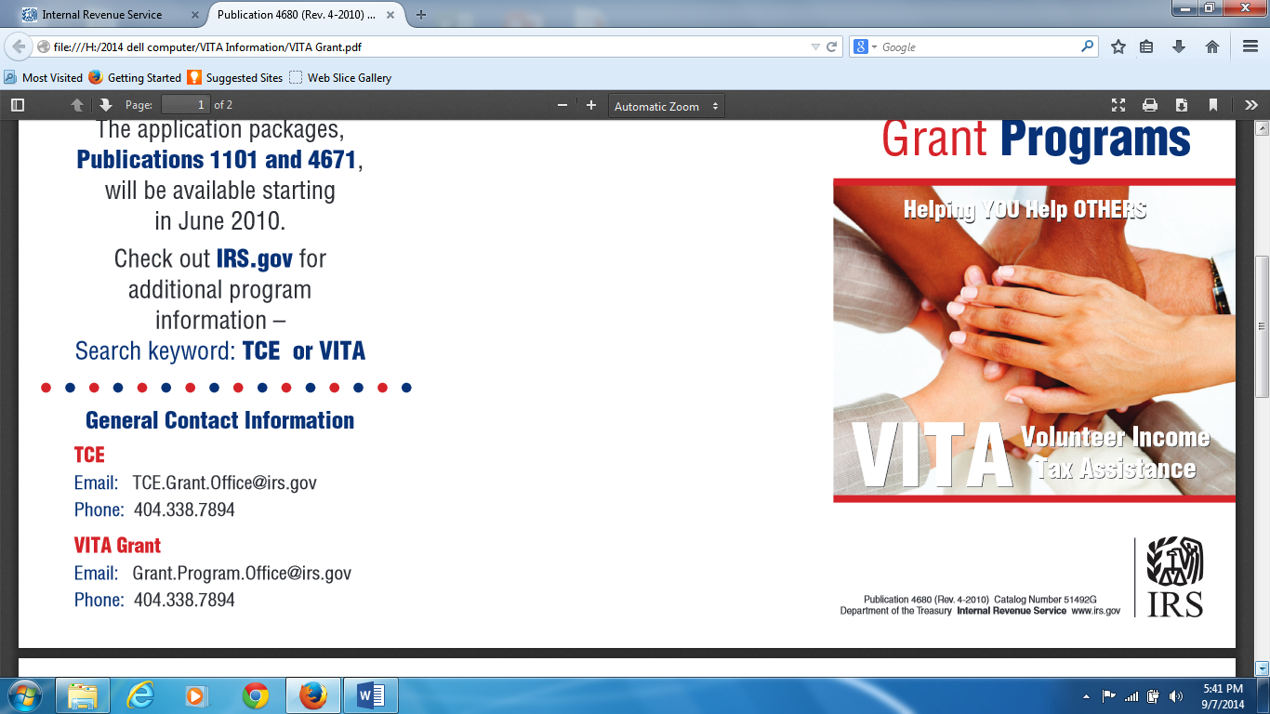
VITA: Service Learning Course
Lessons Learned

Slide 5
VITA Definition
Volunteer Income Tax Assistance (VITA) is a service learning program sponsored by the Internal Revenue Service (IRS) whereby student volunteers prepare income tax return for the low income (that includes students) and elderly at no cost.

Slide 6
VITA History
The VITA program originated with the Tax Reform Act of 1969 as part of the increased emphasis on taxpayer education programs
Russ Norman brought it to our college in 1970. GCC provided a classroom for the lecture and the students performed the free tax service at other sites.
1997 russ Norman retired and I was given the class by Evelyn Spicer. Slowly evolved away from IRS instructors to GCC instructors and our own site.

Slide 7
Requirements
Prerequisite for Acctg 155 (VITA- Lecture) is Actg 150 Personal Income Tax. We found a higher level of preparers. It is the application of the theory the students have learned.
Once the student passes the IRS test they can interview clients and prepare taxes (Acctg 156- VITA Lab). We ask that they do a minimum of 7 returns---most do double that amount.

Slide 8

Our numbers
        TaxYear Volunteers #Returns Refund $
        2009 100 800 $750K
        2013 30 280 $275K

Slide 9
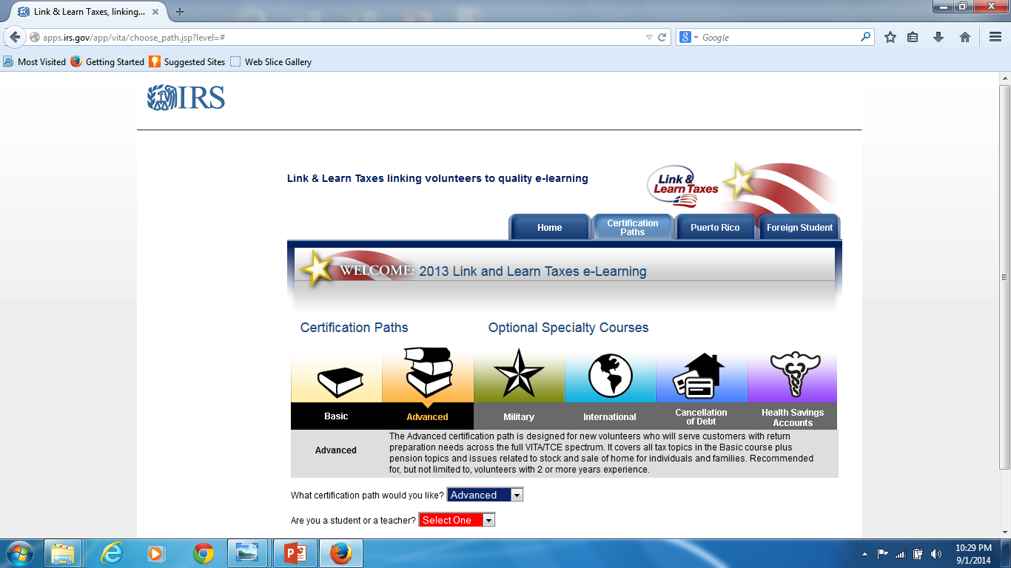
Students take a course in basic tax preparation (Acctg 155-VITA Lecture)

Slide 10
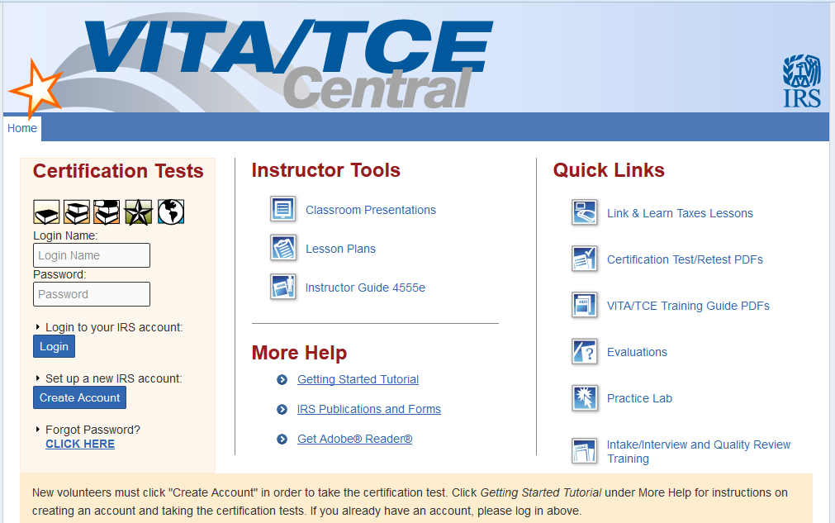
Students take a test

Slide 11
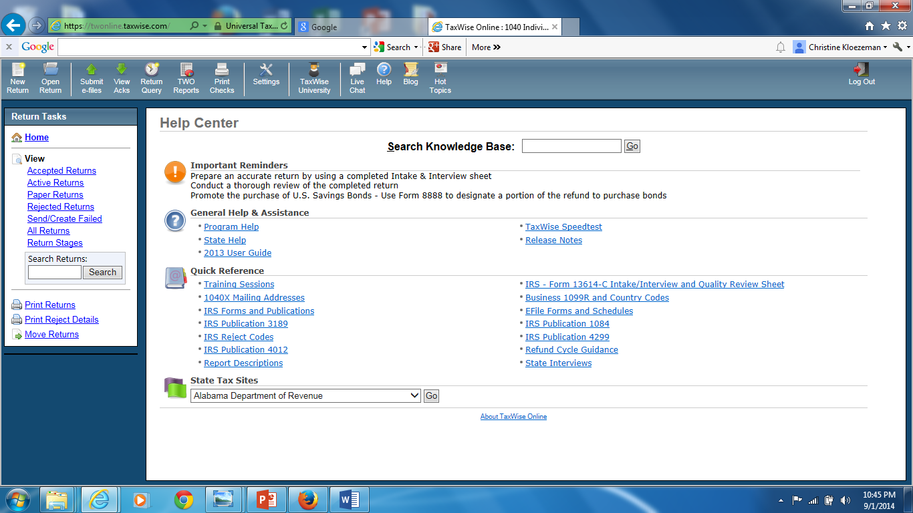
Learn TaxWise: Computerized Tax Program

Slide 12

Set up for Clients

Slide 13

Students are ready to interview

Slide 14
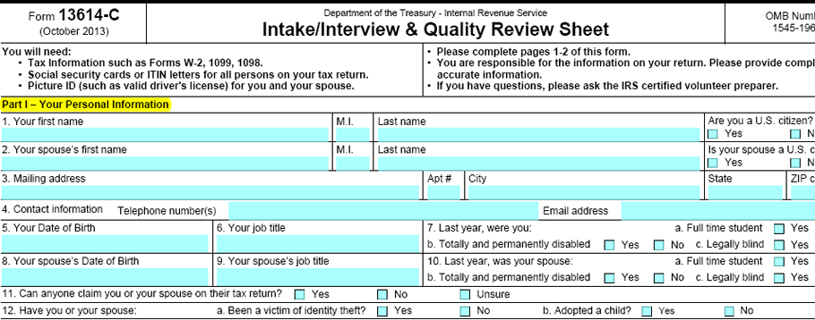
IRS provides Intake Form
Notes:
This is where the student learns to handle personal situation that affect taxes. They learn to be nonjudgmental. Always tell your tax preparer any changes in your life. My friend owed a lot of money in 2013 because she took out a lot cash to fix the elevator and car lift for her husband. She didn’t tell her tax preparer. I did an amended return and she owed only $200 not $4000. I also did the 540X. It wouldn’t have happened if I did not know her family situation.

Slide 15
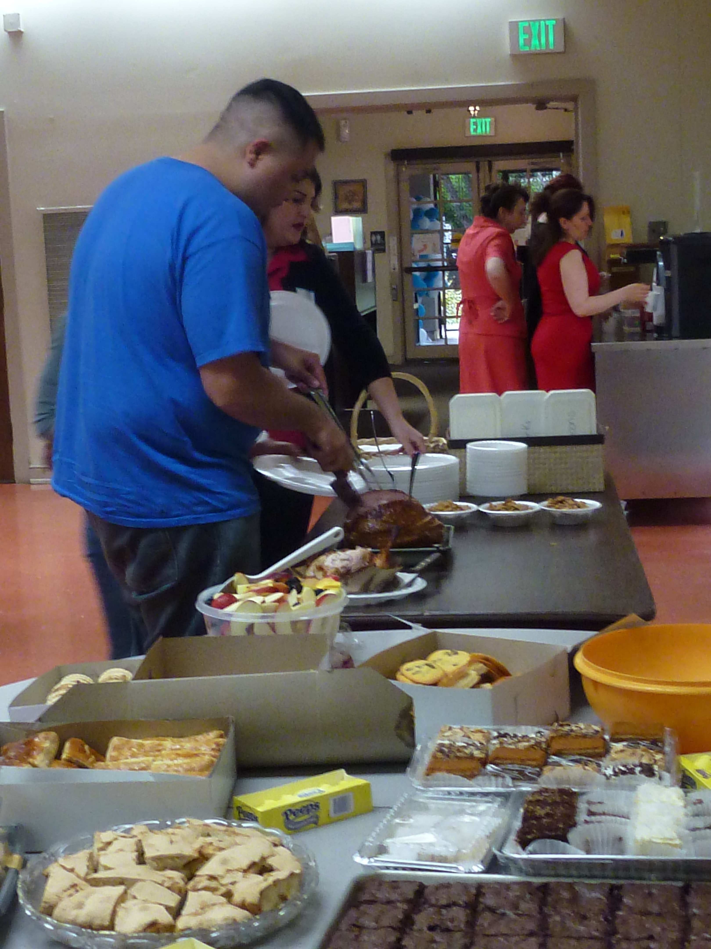
Have a rewards banquet

Slide 16
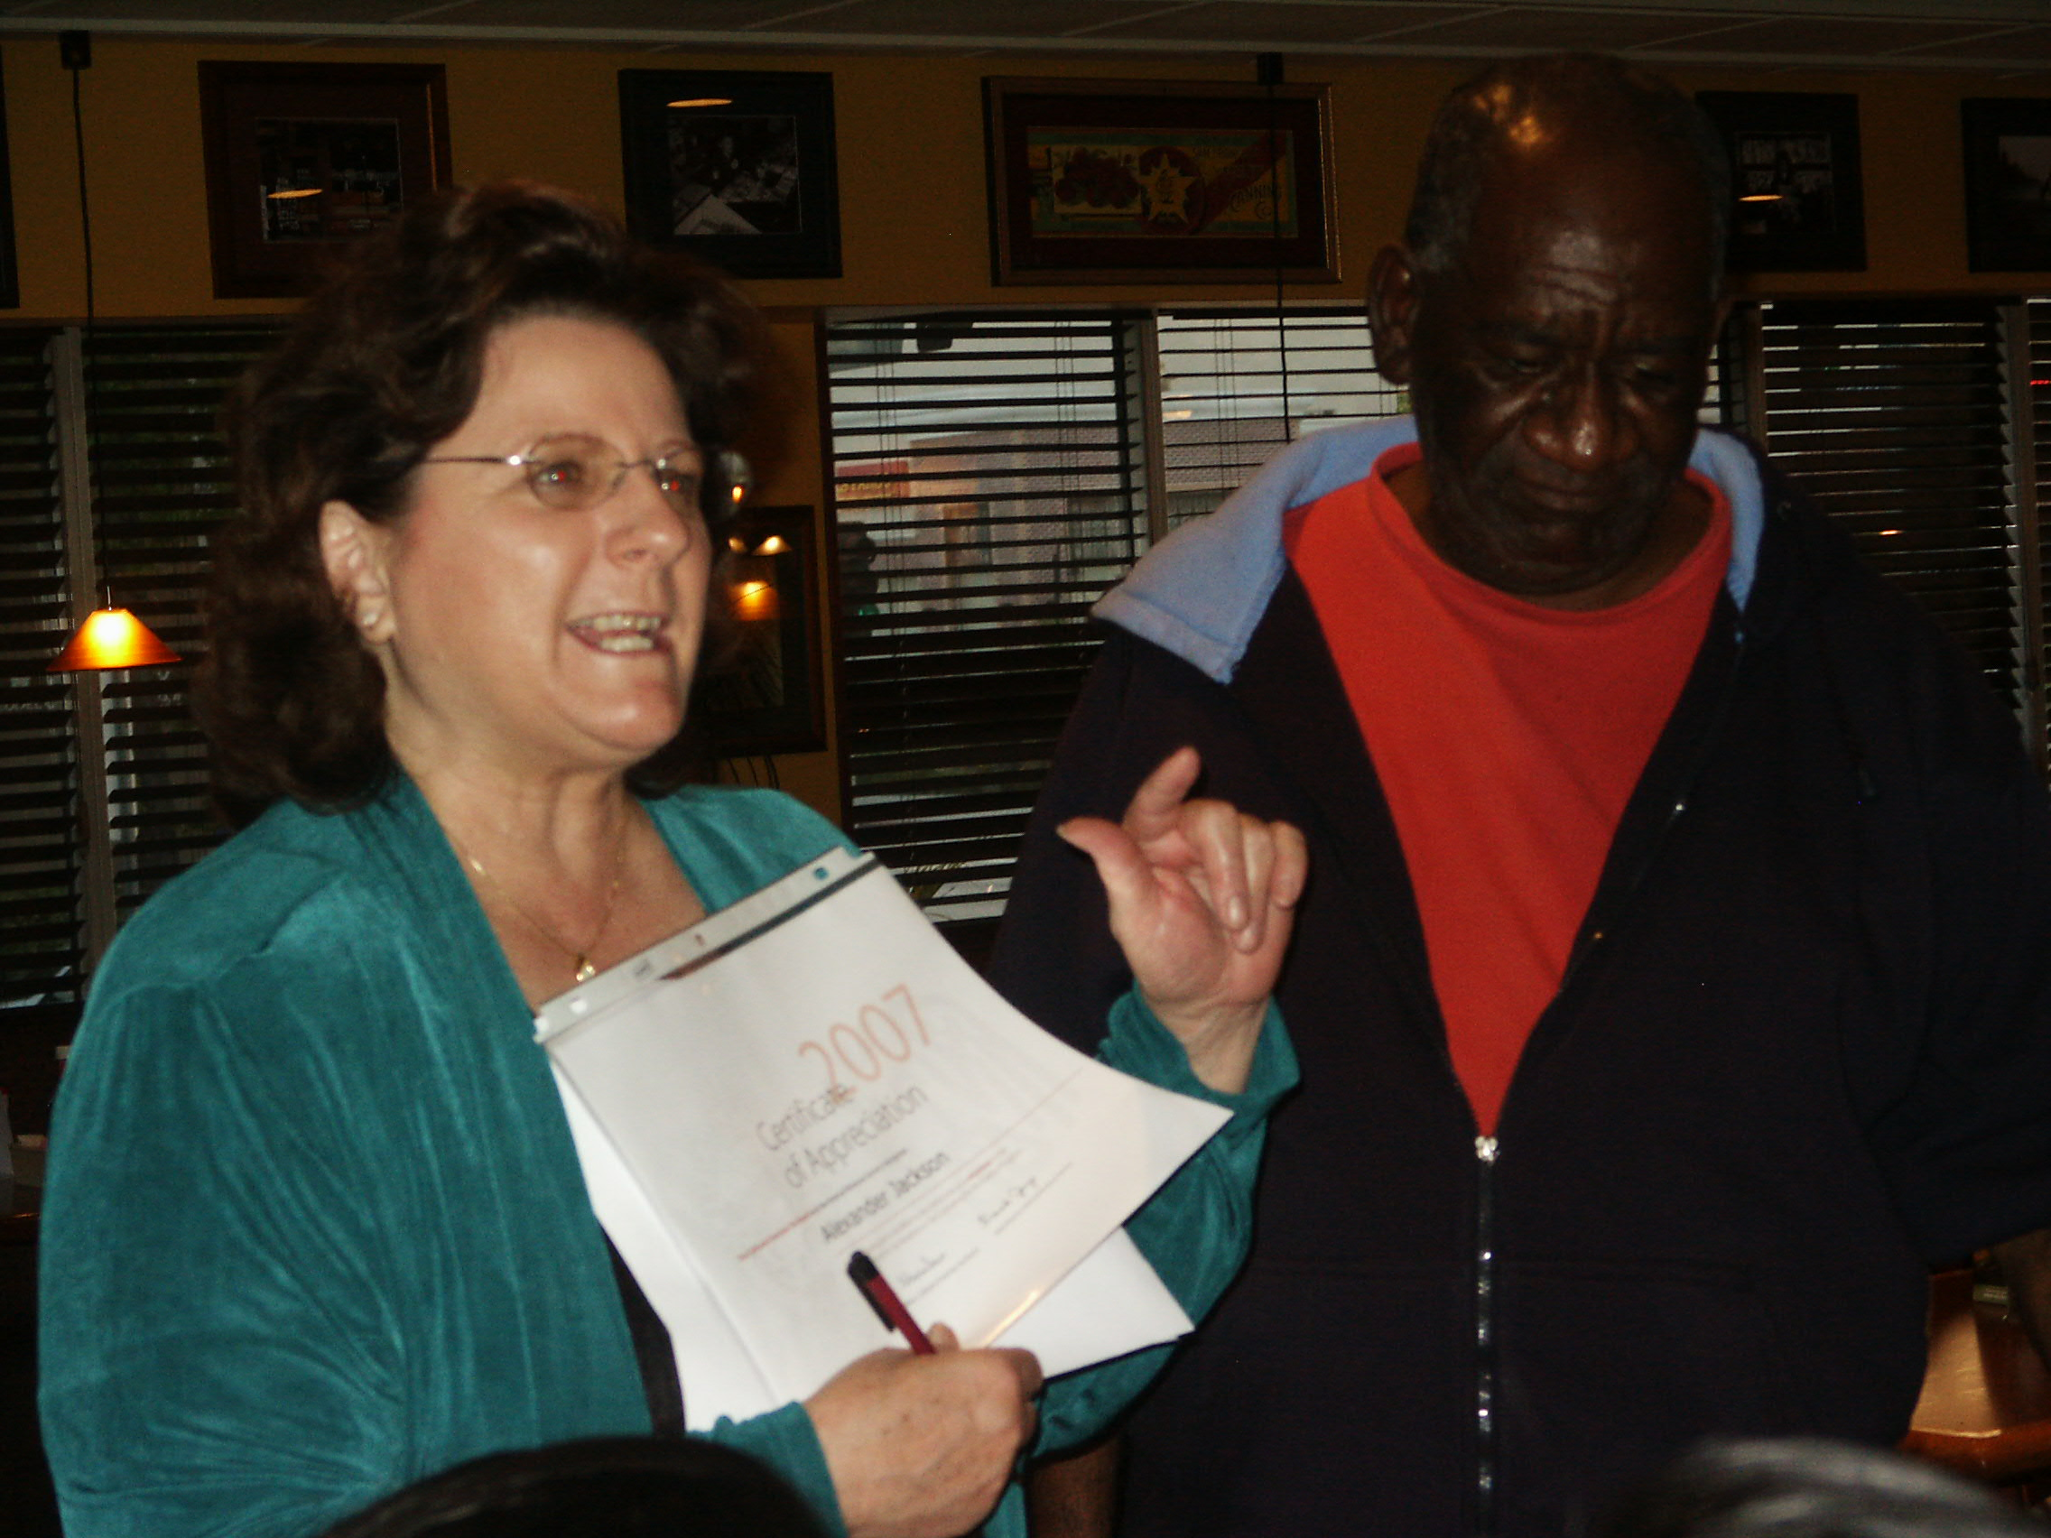
Students receive IRS certificates

Slide 17
After the first year
Students can participate for more than one year. (Acctg 157- VITA Leadership)
They become Quality Reviewers. If transfer to CSUN they become supervisors over their own site.
Some students have taken the Enrolled Agent test so they can set up their own tax service business.

Slide 18
Legacy Members
Students continue to participate as community volunteers without class credit. Some have been doing it every spring for 15 years. They maintain the high quality of the program.

Slide 19
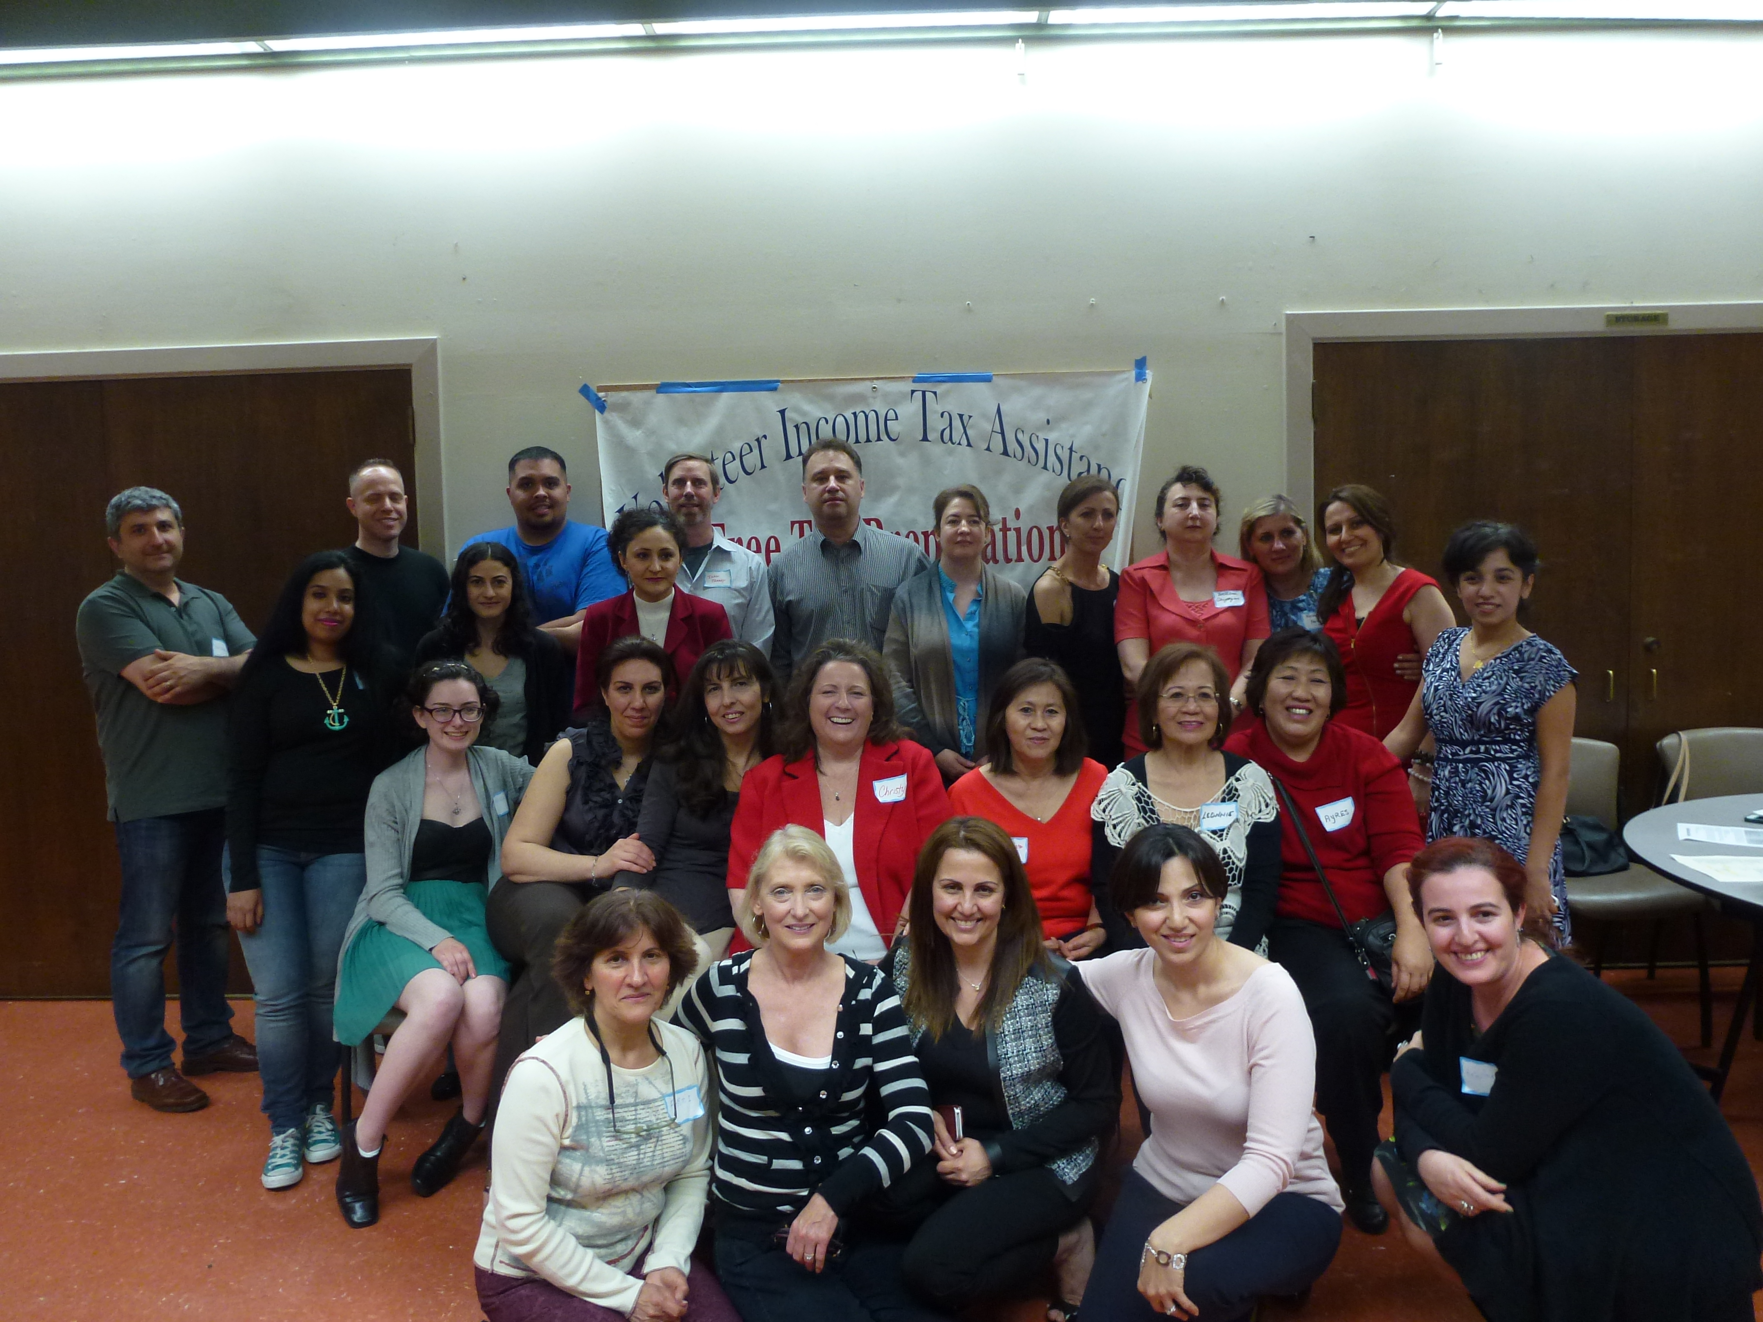

Slide 20
Students Learn
Client Interview techniques—asking personal questions gently
Confidentiality
Basic Computerized Tax Preparation Program
Organize the return (Federal and State)
Explain the return to the client answering questions

Slide 21
What I have learned
Have respect and appreciation for students—keep telling them.
Don’t get too big—keep it to a size you can handle
  People will want you to grow--- choose a size and stick to it
If you want it to continue after you, make sure you are getting appropriate pay. No one will have the passion that you will have and work for nothing.
Ask for help – you need your Division Chair’s support
Keep Statistics about your program and take a lot of pictures.
  You constantly have to prove your program is viable. Others will want you to fail.
Notes:
VITA grew the most under Linda Serra’s advisement—she always did her best to make sure I got paid as much as possible and had as much help as possible.

Slide 22
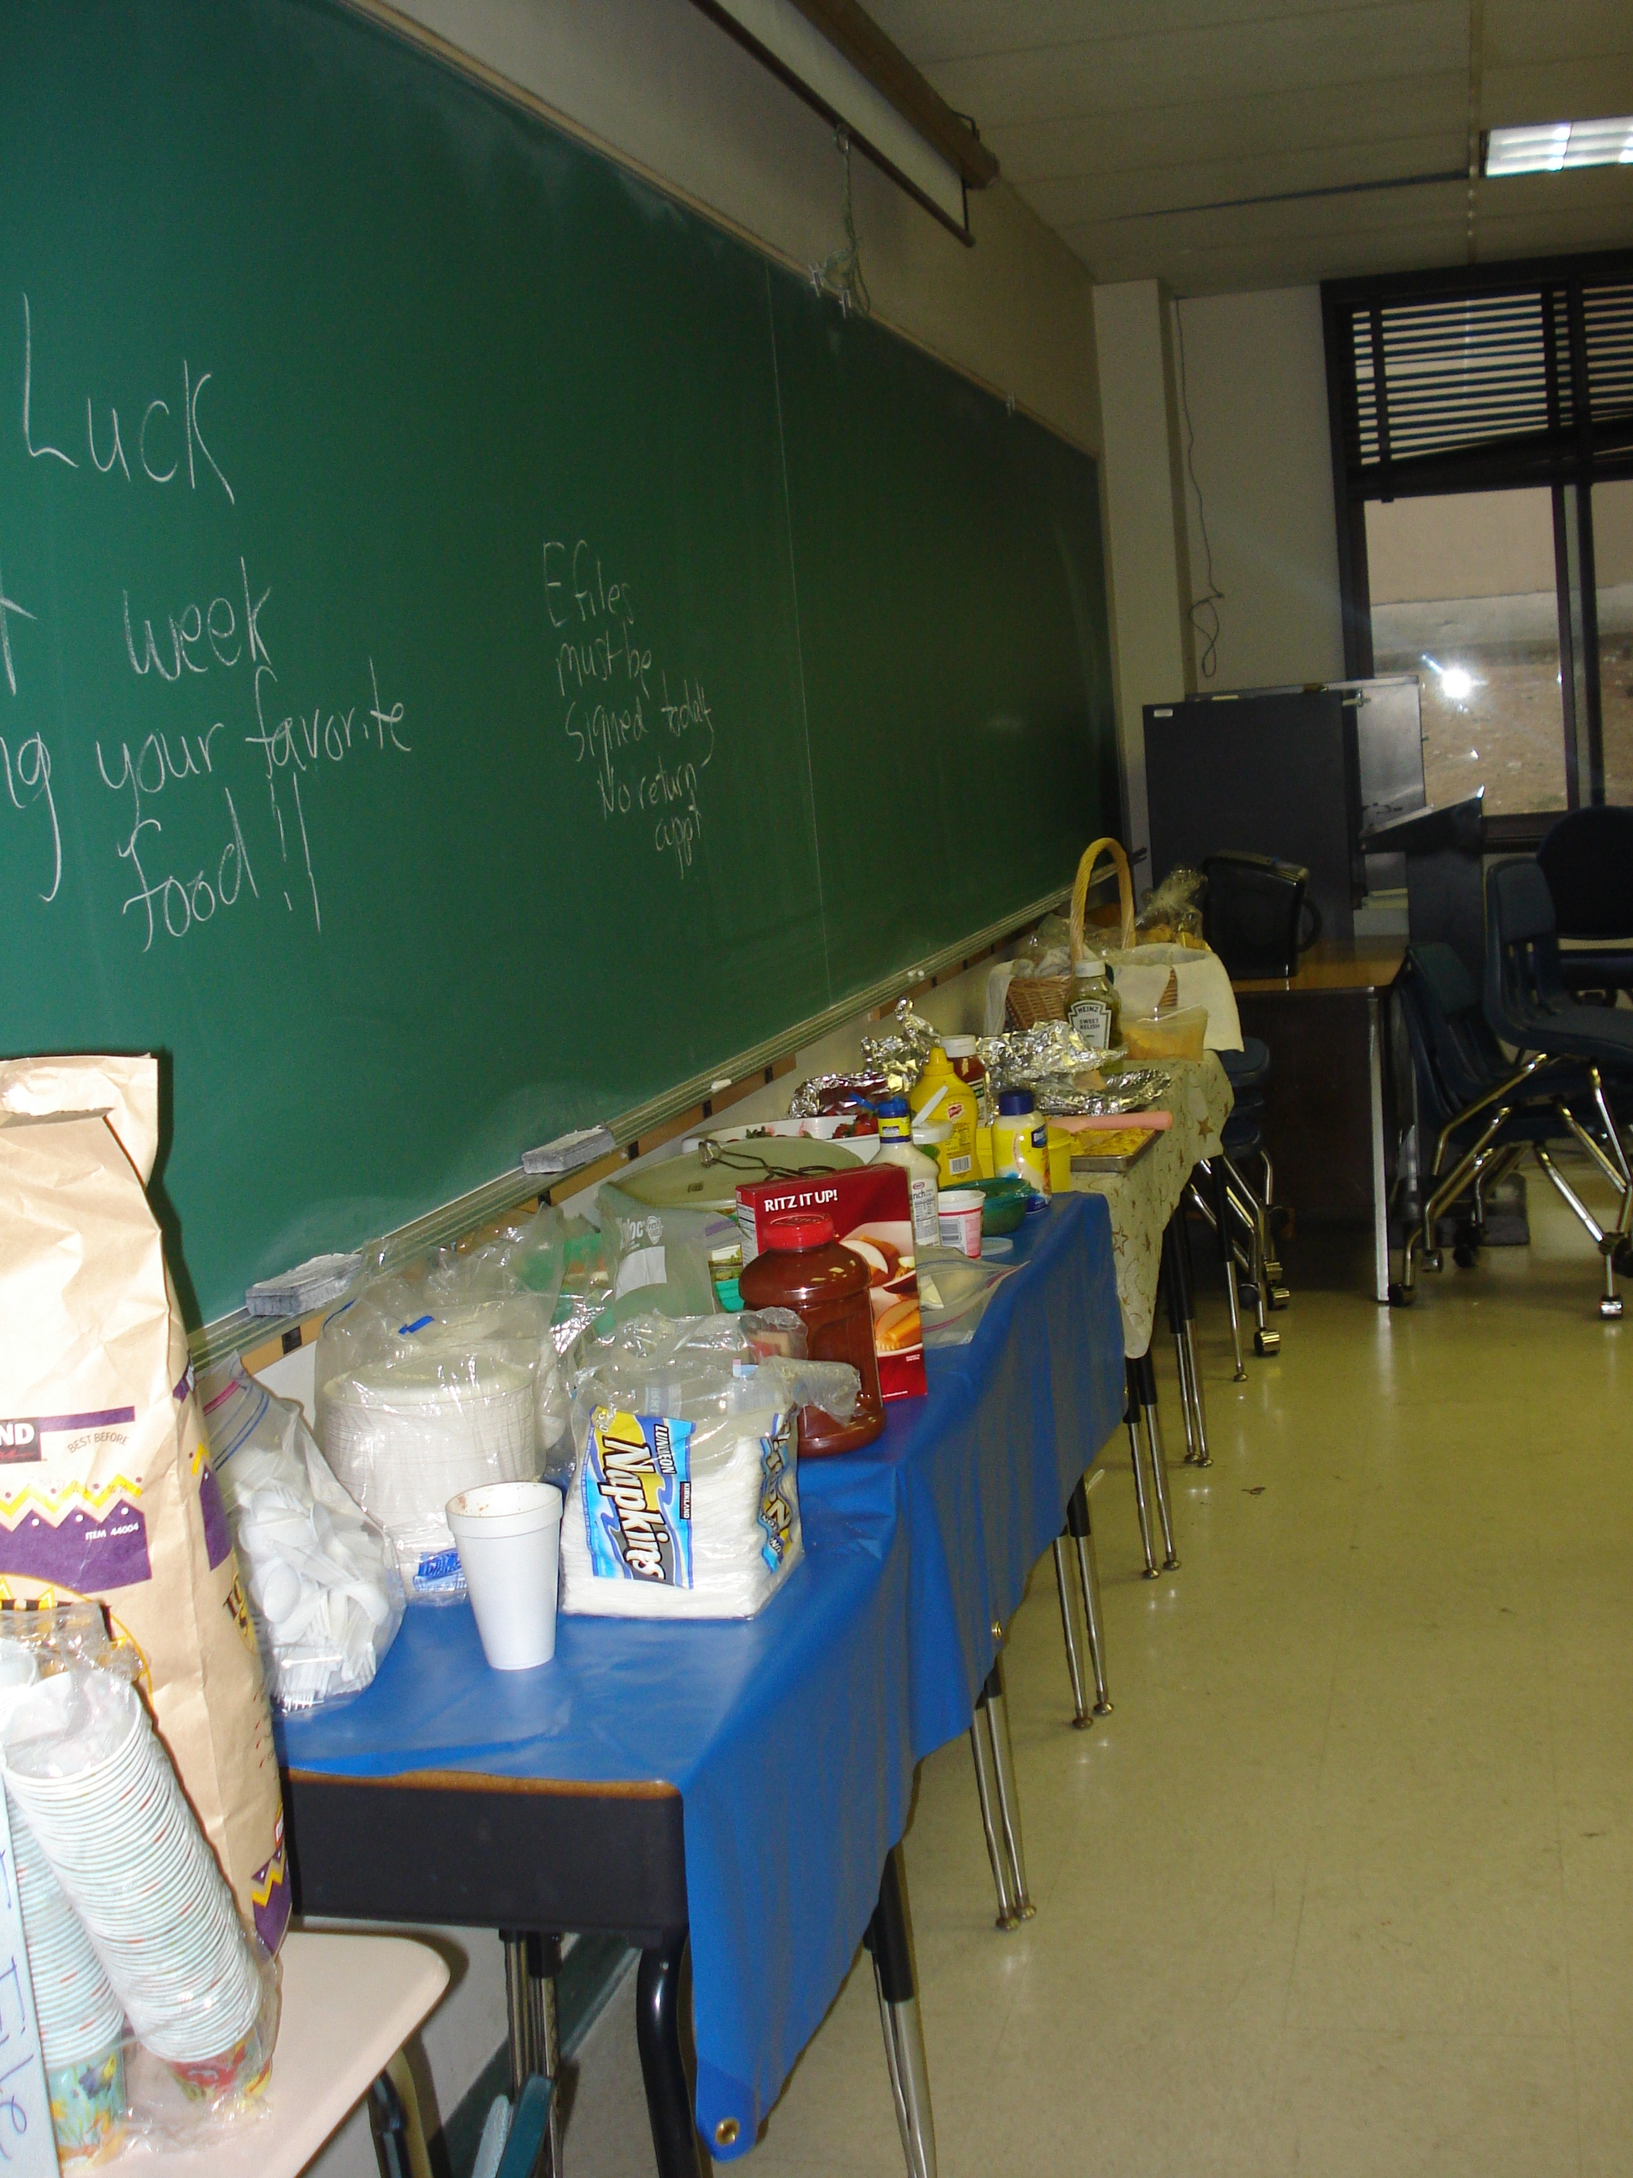
Feed them:
Nothing makes students feel like a family more than food.
Notes:
I started supplying food when one student went into a diabetic comma because she got so focused doing someone taxes she forgot to eat. It got to be such a treat for student it was the only food they had for the day. I stopped doing it when clients came in and started eating then complained that the students were having a party instead of doing their taxes. It was costing me $200/week for 8 weeks.

Slide 23
Real Estate or IRA/STRS
How to get a higher return with real estate

Slide 24
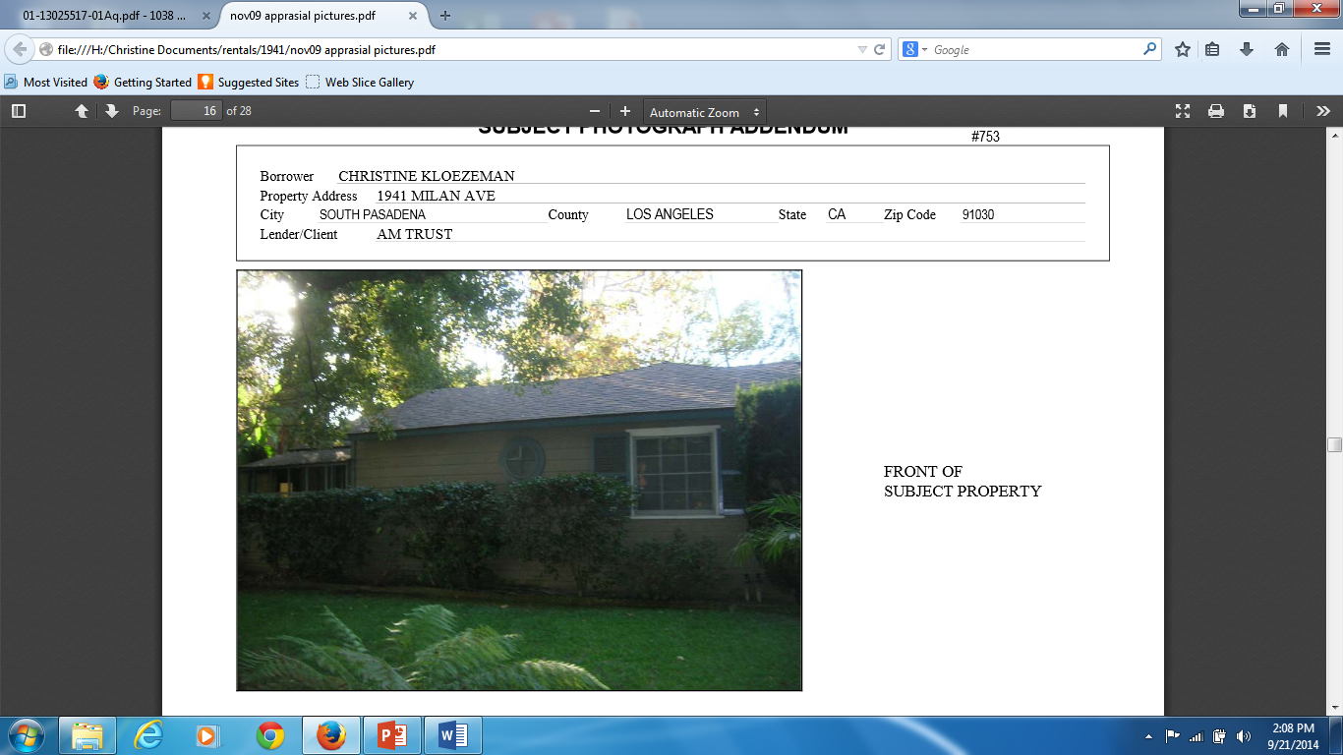
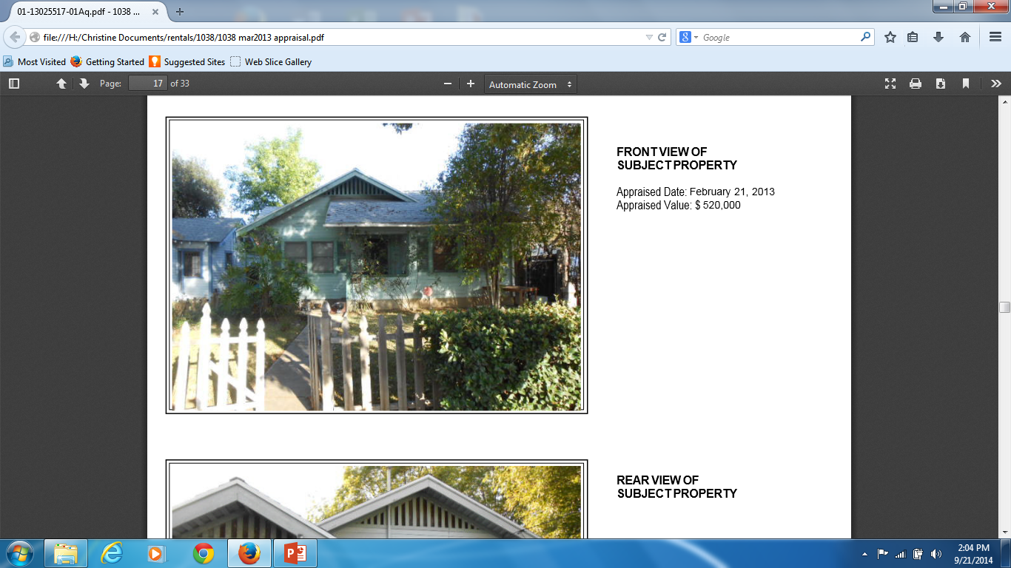
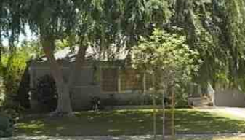
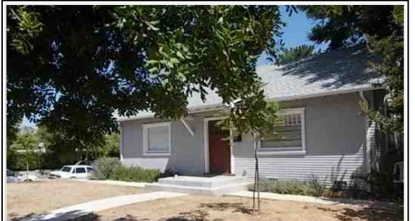
$2,800 A
$1,900/$1,200 B
$2,500 C
$2,500/$900 D
Notes:
Over the 42 years of marriage my husband and myself have purchased 4 homes as our retirement income. We currently get 11800 in rent but pay mortgages of 5240 per month. Lets look at more details.

Slide 25
Basic Principles
Always Buy, Never Sell (Not for real estate professionals)
Always Long Term– over 40 years (Not Flipping)
  Must start when young and then add rental properties every 5 years
Location, Location, Location
Keep investments to no more than 3Bed-2Bath properties

Slide 26
Basic Principles con’t
Limited to 4 properties as a non-real estate individuals
Budget for 11 months of rent
Assume 10% of rent for maintenance
Only interest on mortgage is tax deductible---principle payment does not count for taxes but use mortgage payment for cash flow

Slide 27
Basic Principles, con’t
Update your properties (A/C, Hardwood floors, Sprinklers) while you are working so costs are lower when retired
Depreciate while you are working to have a non cash loss on taxes (note: if you sell your property you will need to add back in the depreciation to increase the amount of gain on which to pay income tax

Slide 28
Basic Principles, con’t
If good tenant don’t increase rent---will lose more money than you would gain
Don’t pay attention to market value—as long as you get enough rent to have a positive cash flow you will be ok.
Market Value is important if you plan to refinance. Credit Score also.

Slide 29
Passive Participation
Income is considered Passive if you have a management company handling your properties
Can only write off expenses to the net income--- no loss can be recorded

Slide 30
Active Participation
You do all the real estate work (collect rent, search for tenants, pay bills, supervise repairs, manage tenants)
Don’t need to have a real estate license if it is your own property
If you have a job you must spend more time at Rental work than at your job.

Slide 31
Active Participation Con’t
Must be over 250 hours in real estate activities if you have a job
If no other job, you must have 750 hours in real estate activities (husband retired)
Can declare a $25000 loss or less if additional income. (if tax rate is 20% that is a tax savings of $5000—don’t need to pay taxes on it when you pull it out)

Slide 32
Disadvantages
Hassle of Management –Can’t leave and forget it
If you get a bad tenant– can have a loss of rent and need to go to court for eviction.
If you decide to sell will have higher taxes if you have depreciated the properties

Slide 33
Tax Tips

Slide 34
Tax Basics
Cash Basis – what you paid and what you received from Jan 1 to Dec 31. Make all expenditures before Dec 31.
Your status is as of December 31st.
If Income – then you can record expense----no income , no expense to match

Slide 35
Suggestions
Always record where you got your information---what authority you relied upon (pub 17, IRS pamphlet, called IRS—get name and number)
Must keep both your receipt and your form of payment. Just receipts is not good enough anymore

Slide 36
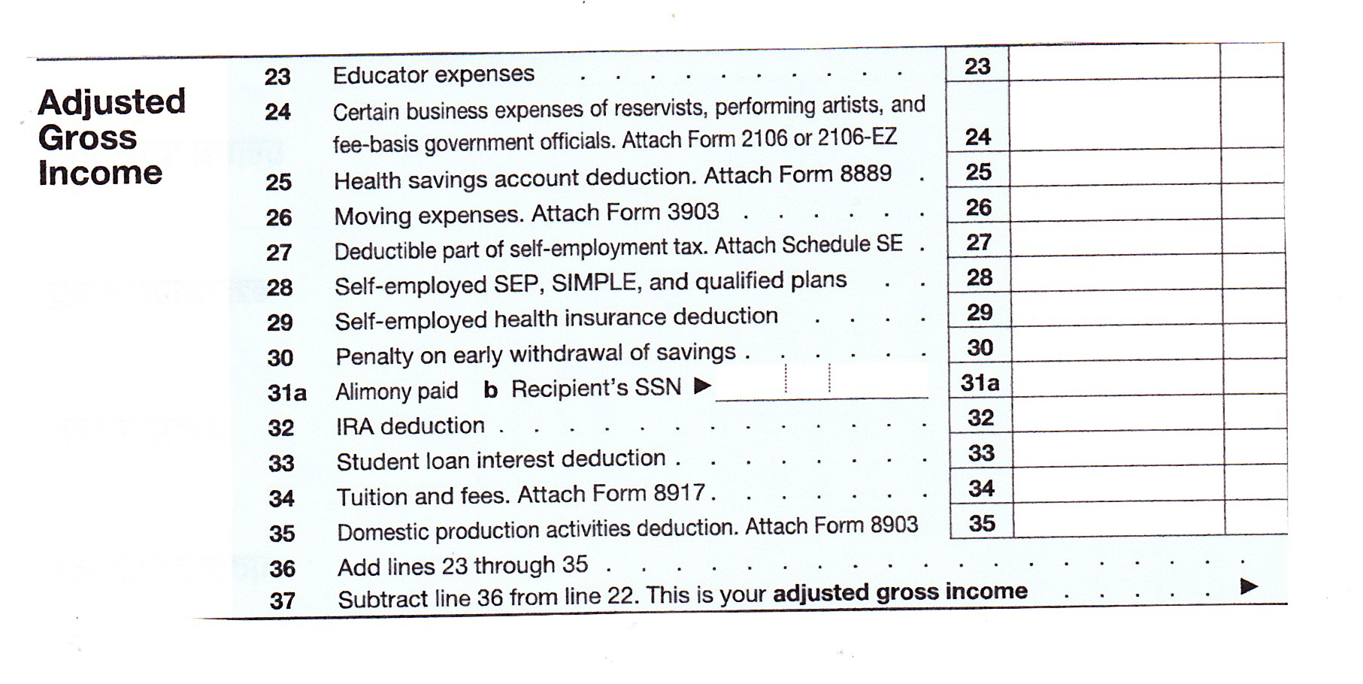
1040 -Adjustment to Income

Slide 37
Standard Deduction-2013
Single or Married Filing Separately $ 6,100
Married Filing Joint or Qualifying Widow $12,200
Head of Household $ 8,950

Slide 38
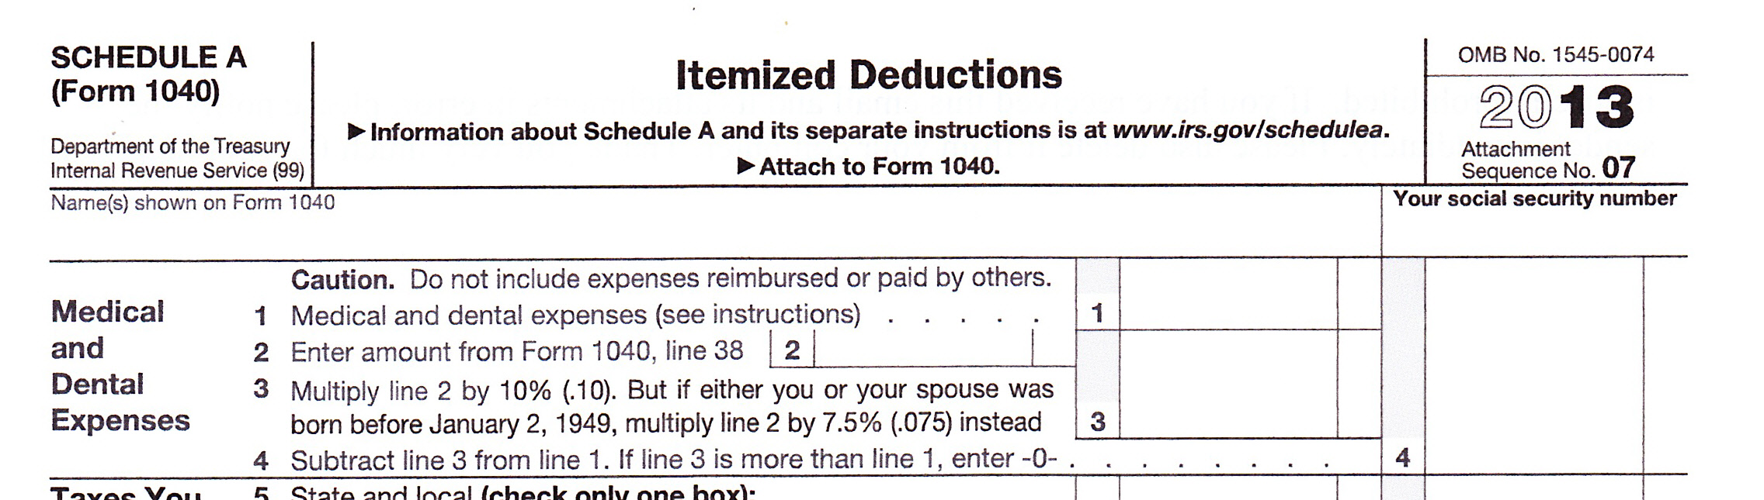
Schedule A- Medical
Notes:
Includes insurance and any co pay. Also if need to modify your house for a disabled person. Prescription drugs but not over the counter. Only if over 10% of AGI. Most people don’t get this deductions because of the 10% limitation.

Slide 39
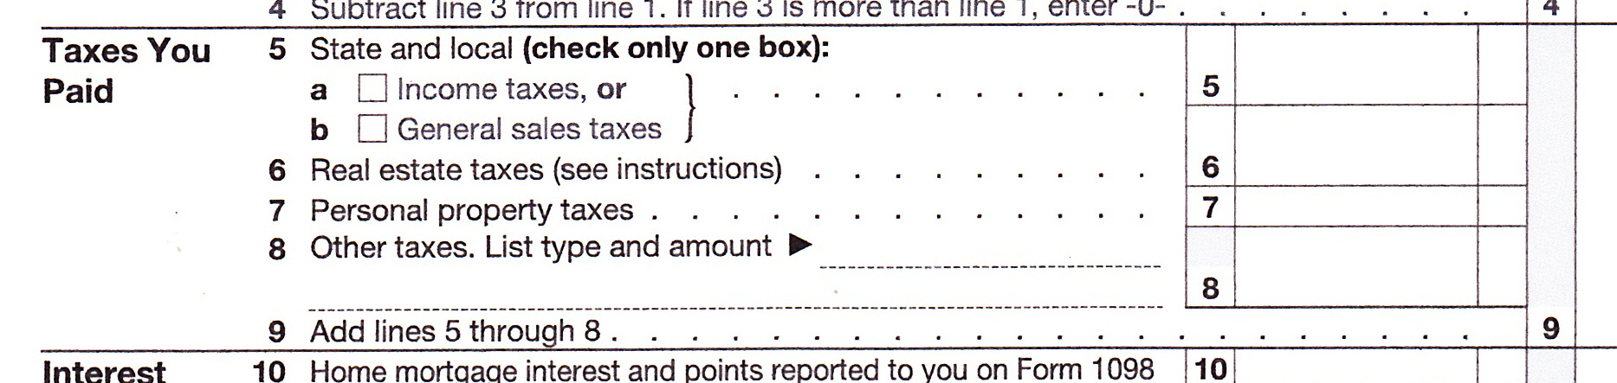
Schedule A – Property Taxes
Notes:
Remember real estate taxes for both your home and a vacation home. Personal property on DMV charges—only the property tax amount not the full amount of registration.

Slide 40
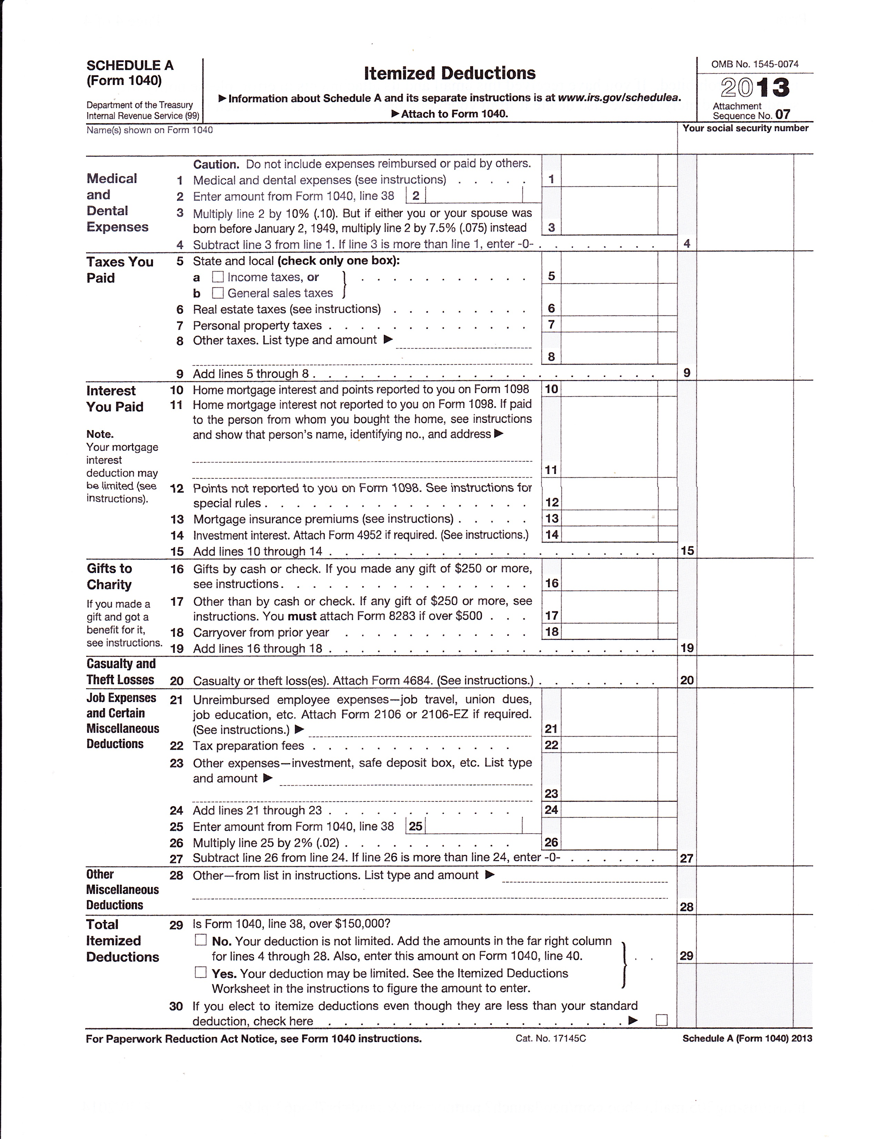
Schedule A – Interest Expense
Notes:
Can also include interest on 2nd home but only interest on loan up to $1 million dollars

Slide 41
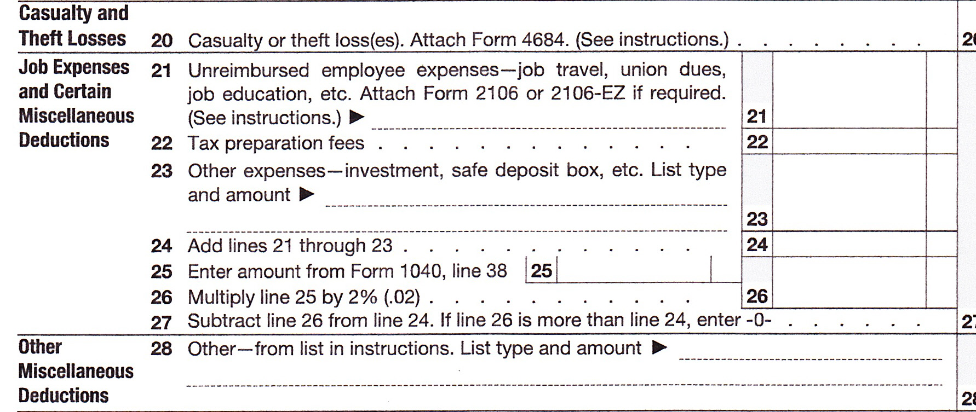
Schedule A - Misc
Notes:
Guild dues, travel between one job and another, anything you buy for your classes that you are not reimbursed, conferences that college doesn’t pay for.
Investment expenses if you have investment income, safe deposit box if you have investments. Another limitation of 2%.

Slide 42
Schedule A – Absolute Miserable Tax (AMT)
Notes:
Alternative Minimum Tax This is where your loss on rental activities helps. Line 38 is adjusted gross income which is reduced by your rental income loss.

Slide 43
The IRS
The Good, Bad and Scams

Slide 44
SCAMS Using the IRS Name

Slide 45
The IRS will never:
1. Call you about taxes you owe without first mailing you an official notice.
2. Demand that you pay taxes without giving you the opportunity to question or appeal the amount they say you owe.
3. Require you to use a specific payment method for your taxes, such as a prepaid debit card.

Slide 46
The IRS will never:
4. Ask for credit or debit card numbers over the phone.
5. Threaten to bring in local police or other law-enforcement groups to have you arrested for not paying.

Slide 47
If you get a call
1. If you know you owe taxes or think you might owe, call the IRS at 1-800-829-1040. IRS workers can help you with a payment issue.
2. If you know you don’t owe taxes or have no reason to believe that you do, report the incident to the Treasury Inspector General for Tax Administration (TIGTA) at 1-800-366-4484 or at www.tigta.gov.

Slide 48
If you get a call con’t
3. If you’ve been targeted by this scam, also contact the Federal Trade Commission and use their “FTC Complaint Assistant” at FTC.gov. Please add "IRS Telephone Scam" to the comments of your complaint.

Slide 49
Remember, too, the IRS does not use email, text messages or any social media to discuss your personal tax issue. For more information on reporting tax scams, go to www.irs.gov and type “scam” in the search box.

Slide 50
How IRS Communicates with you

Slide 51
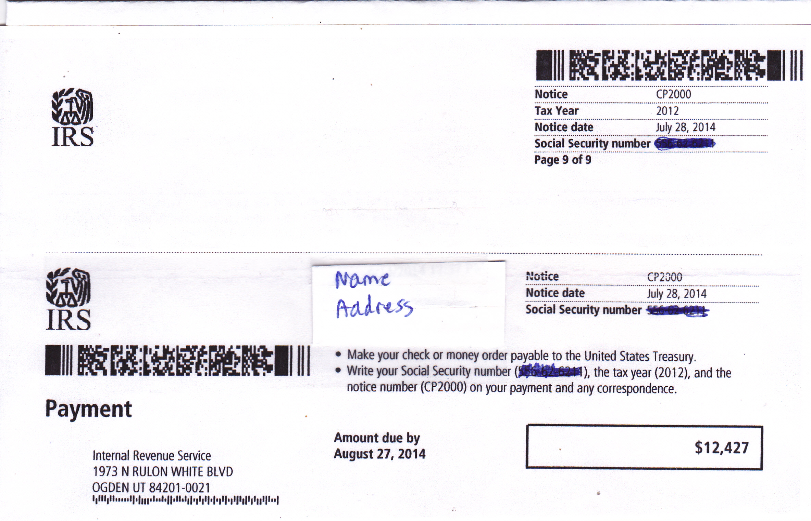
Notes:
The CP2000 is one way the IRS will communicate with you. This one is for shock affect. This person did not receive the 1099s for investment withdrawals. IRS recorded just the amount received not the basis or the amount they paid for the investment. The date due is 30 days but if you call for an extension the IRS will tell you there are no extensions and it is due in 60days even though the document says 30 days.

Slide 52
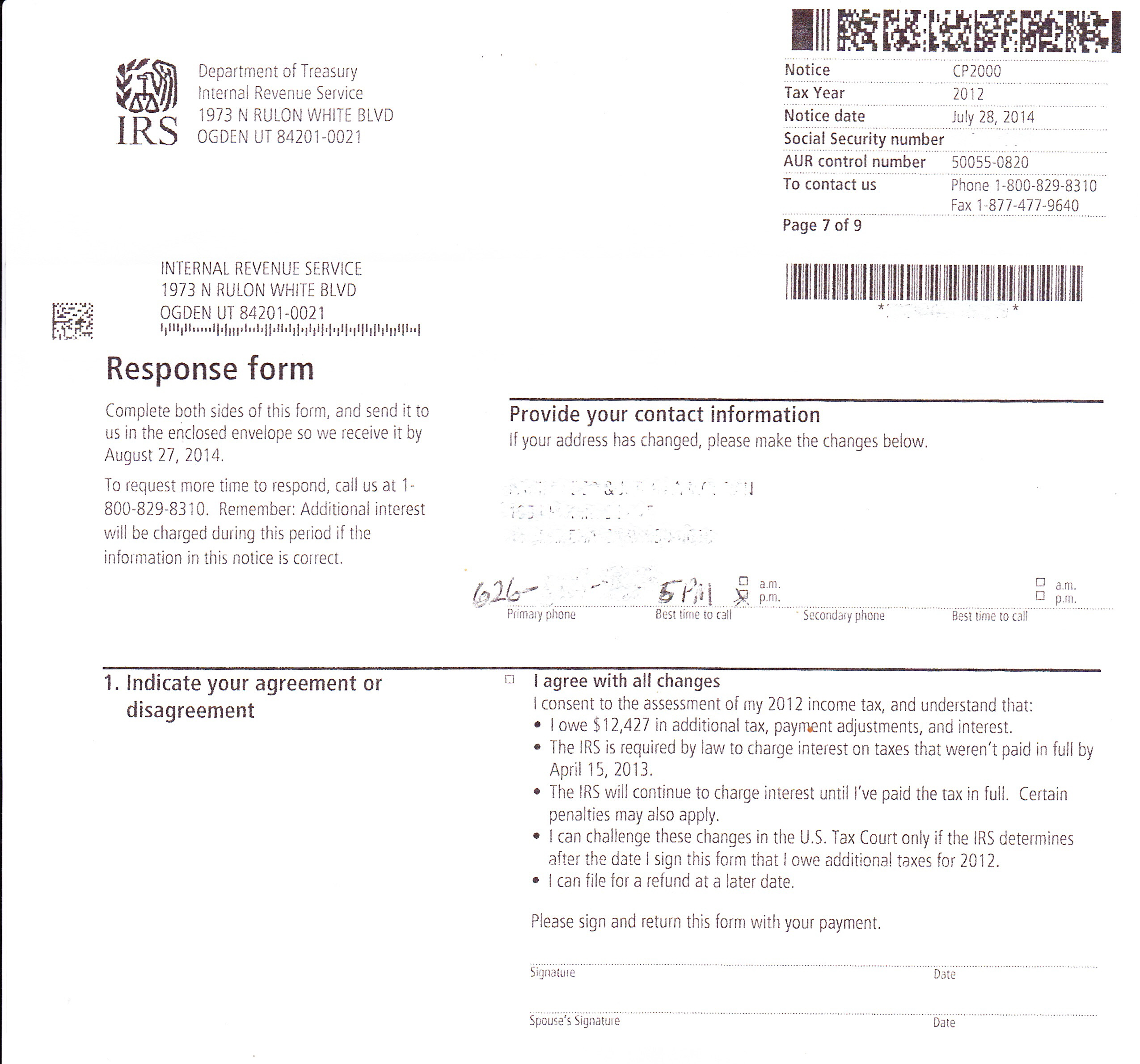
Notes:
This is the response page that you tell them if you agree with the changes. The next page says you don’t agree. I did an amended return so she didn’t owe any money. She was going to set up an installment arrangement but luckily she talked to me first. Only have to pay on the increase income not on the amount of cash received.

Slide 53
Don’t Be Afraid to Challenge
If you don’t agree with the first IRS person you can always ask for the supervisor.
If you don’t agree with the supervisor you can always ask for an appeal.
There are good and bad people at the IRS, as in any organization. You just need to find the person who will help you.

Slide 54
Don’t Be Afraid to Challenge con’t
State lags a couple months behind the federal.
Don’t work with a Bully!!! Ask for a new person if that happens.
THERE IS ALWAYS A 1040X/ 540x

