Slide 1
Process Costing

Slide 2
Purpose
assign material, labor, and manufacturing overhead costs to products and to provide a mechanism for computing unit product costs.
Same accounts and same cost flow as Job Costing

Slide 3
Three Inventory Accounts
Raw Materials
Work In Process
Finished Goods
WIP and FG is easy with Job Cost. The job is either finished or not.
Use process costing if there is an amount for beginning and ending inventory.

Slide 4
Unit Cost
Direct Materials
Direct Labor
Overhead
PRIME COSTS: DM, DL
CONVERSION COSTS: DL , OH

Slide 5
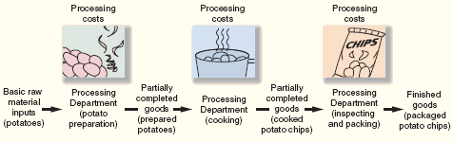

Slide 6
Process vs Job
Process is one product, continuous basis
Costs are accumulated by department
Total unit cost is the total of each department’s unit cost.

Slide 7
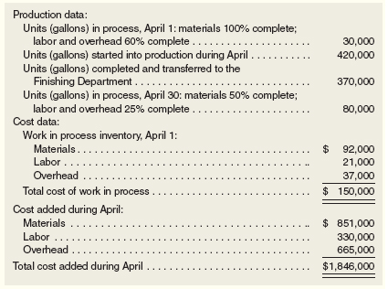
Production Data

Slide 8
Cost Reconciliation Report
Summary information on Quantity Schedule
Three parts
  Schedule of Equivalent Units for Materials and Conversion
  Unit Cost Analysis
  Cost Summary– what balance is in WIP and FG

Slide 9
Exercises
4-10
4-11
4-13
4-15
Quiz– on the problems, if there is no answer write it in

