Slide 1




Are You Connected?
Glendale Community College
ACCTG 102
Notes:
“Education companies can no longer ignore that you, the students, are demanding a more effective, more efficient, less expensive education. We want to partner with you to make all of that happen, and let you know that we are here for YOU to serve your learning needs.”

Slide 2
How to Earn a Better Grade in this Course
Using McGraw-Hill digital products to improve your performance
The specific resources available for this course and how they will improve your grade
Where to purchase your course materials
Notes:
The technology that is available for your course is _______________ and ______________

Slide 3
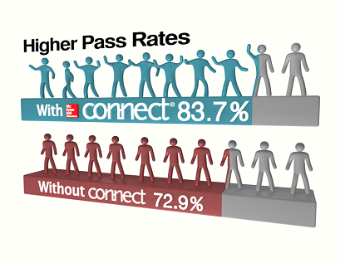
What Connect Means to You
Helps you manage your time most effectively
Works with you to customize a plan for achieving greater performance
Provides feedback and analysis to support your learning needs
Notes:
Connect is a platform for you to access your course materials anytime and anywhere
Connect gives you access to your assignments, eBook (within Connect Plus), videos, animations, LearnSmart and more
Rather than just a homework management tool, or a place for your instructor to send you emails, Connect is a platform that integrates all different learning focused resources to make life easier, and learning better for students.
Included in Connect which I’ll show to you a little later if we have time are your assignments, personalized study guides, learn smart, your ebook, and recorded lectures from your professor for you to review. If you utilize all of the resources on Connect, you’ll be better prepared to understand what you need to learn and pay attention to when you get to class.
Explain graphic

Slide 4
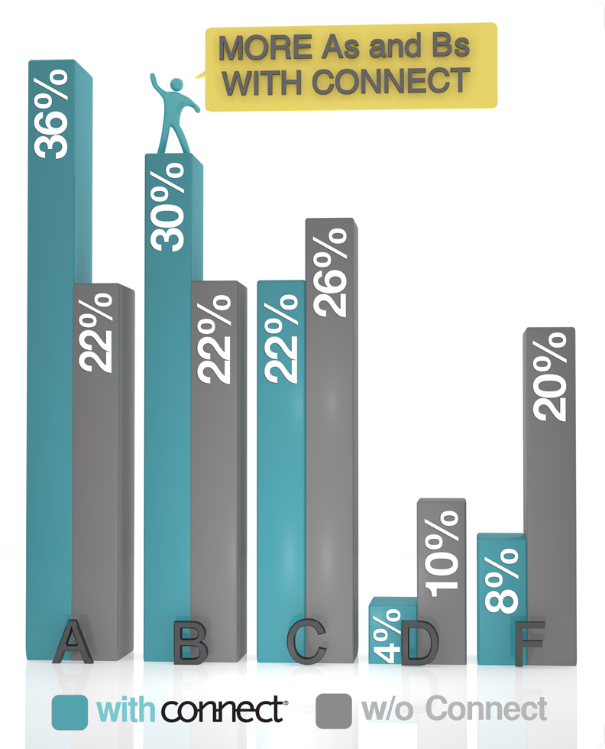
Improved Performance with Connect
Students who use Connect are more successful in the course and receive higher grades than their peers not using Connect.

Slide 5
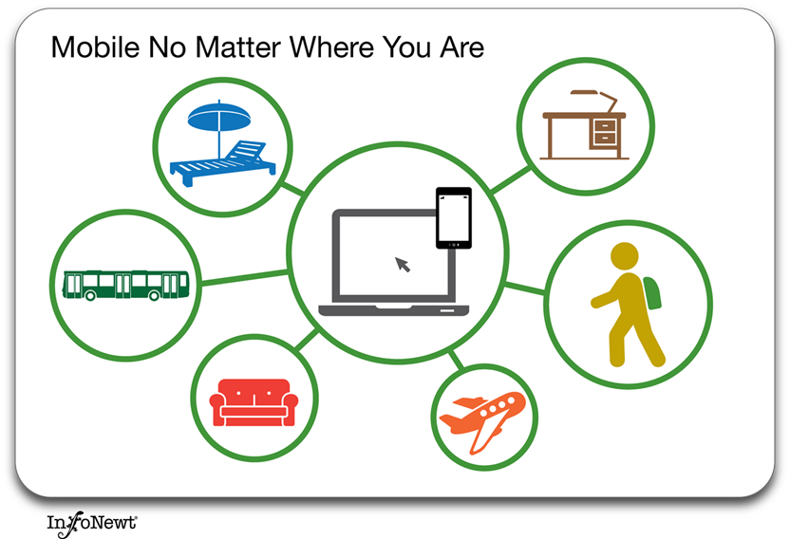
What LearnSmart Means to You
LearnSmart is a proven adaptive learning program.
It is designed to maximize your productivity and efficiency in learning.
Notes:
In addition to Connect, you will get LearnSmart.
Analogy to show the following 3 things: (pandora, amazon, netflix)
1. Saves you time
2. Gets you better grades
3. Eliminates uncertainty

Slide 6
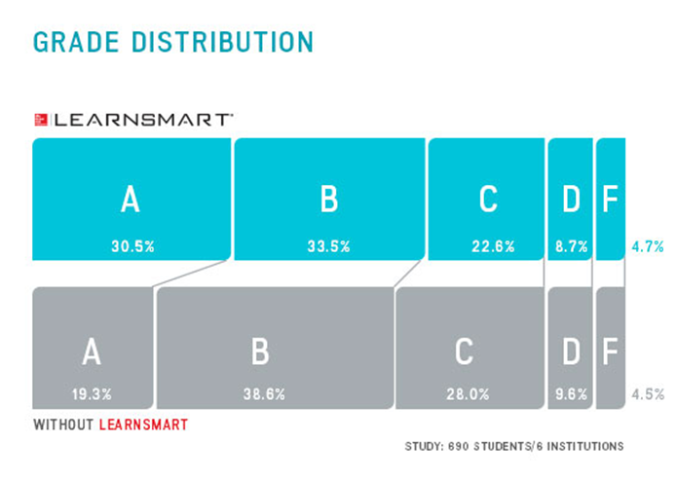
Improved Performance with LearnSmart
Students who use LearnSmart receive higher grades and spend less time studying than their peers not using LearnSmart.
Notes:
Learnsmart is an adaptive learning technology that uses different types of questions to learn about how you learn, while you learn. The more you use it, the more it knows about how your brain works, giving it the ability to teach you concepts in the most effective way, in the least amount of time.

Slide 7
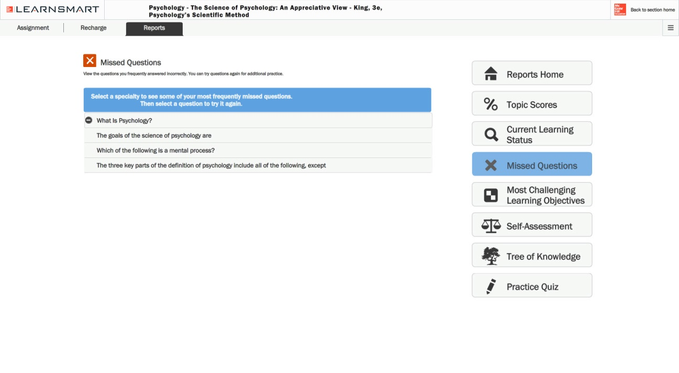
LearnSmart Reports
LearnSmart Reports allow you to track your progress and identify areas of weakness.
Notes:
LearnSmart reports lets you know what you should spend your time studying; With LearnSmart reports, you can view your frequently missed questions and most challenging learning objectives. You can use this information to create customized practice quizzes that focusse areas you need to work on. This way, you don’t have to spend time on topics that you already know, and instead you can focus on those that you do not.
Explain each reporting feature as it zooms in

Slide 8
You have choices!
Go Fully Digital
Connect Plus – Best Option
  All digital, includes the Connect eBook and access to assignments
  Most include LearnSmart and SmartBook 2.0
Visit your campus bookstore
Print Text + Connect Plus
  Includes everything within Connect Plus and the printed textbook

Slide 9
Connect Plus
The Best Value and Experience
Part of your grade: Your instructor is requiring Connect for this course.
Portable: Access all of the required online assignments, an eBook, and study resources from any computer.
Price: Connect Plus is typically HALF the price of the printed textbook.

Slide 10
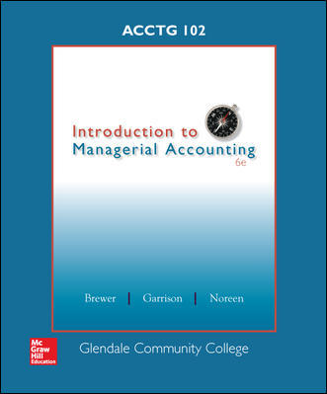
Your Required Materials
Brewer, Introduction to Managerial Accounting, 6e with Connect Plus
9781259432187
Notes:
So what do you need to get started.
Here we have the book that your professor will be using to teach the course, the connect product (that comes with Learnsmart) paired with it, as well as the URL you need to log into your class site

Slide 11
Purchasing Options
$140.25*
Brewer; Introduction to Managerial Accounting, 6e with Connect Plus
$125
Connect Plus standalone – includes eBook
No printed textbook
$245*
Price of components if purchased separately!
Price at bookstore
Online purchase price
Save $104.75 by purchasing at the bookstore
$80
Connect standalone – no eBook included
You will need a copy of the printed book
Online purchase price
*Prices are approximate

Slide 12
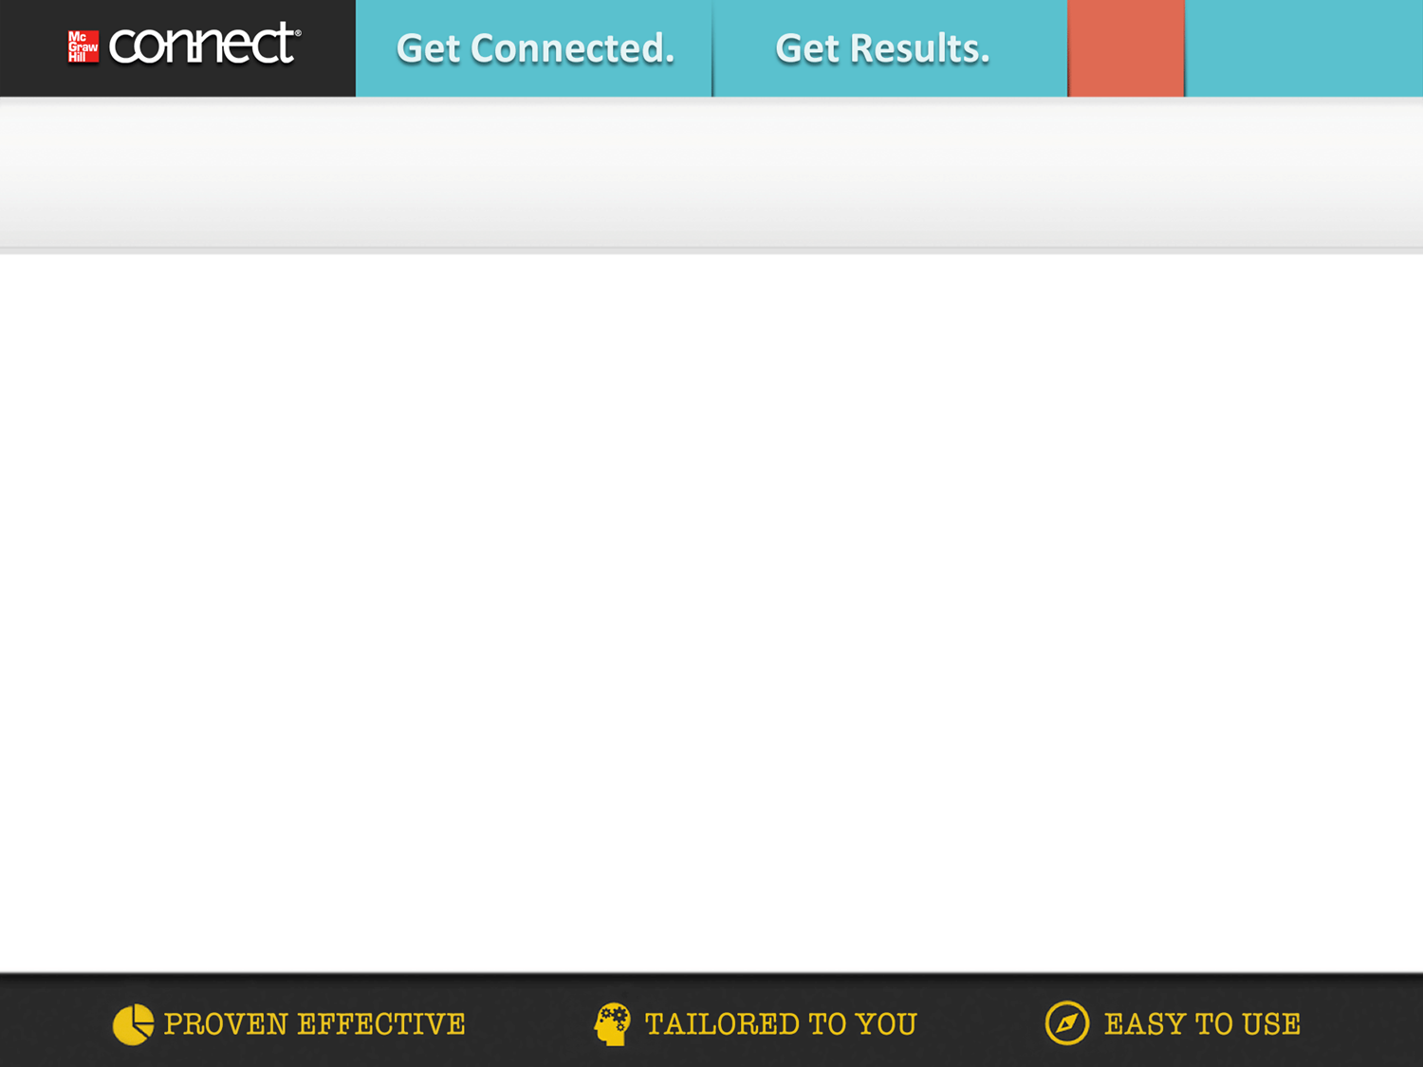
Get Started in 4 Easy Steps!
Go the web address provided by your Instructor and click the “Register Now” button.
Enter your email address
Enter your access code, or select “Buy Online,” or you can “Start courtesy access” if you don’t have an access code.
Complete the registration form and click “Submit”

Slide 13
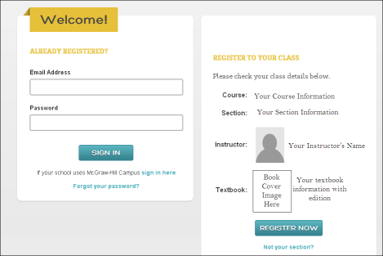
Get Started in 4 Easy Steps!
1. Go the web address provided by your Instructor and click the “Register Now” button

Slide 14
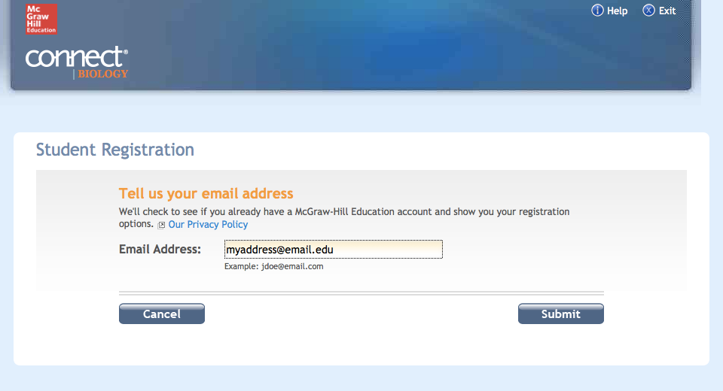
Get Started in 4 Easy Steps!
2. Enter your email address

Slide 15
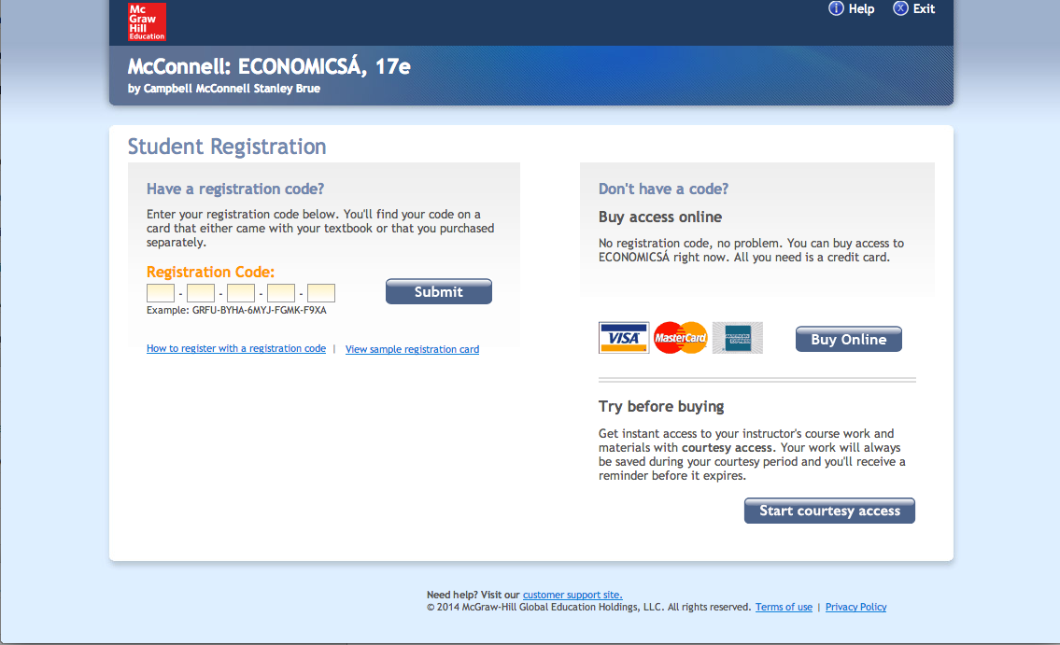
Get Started in 4 Easy Steps!
3. Enter your access code, or select “Buy Online,” or you can “Start courtesy access” if you don’t have an access code.

Slide 16
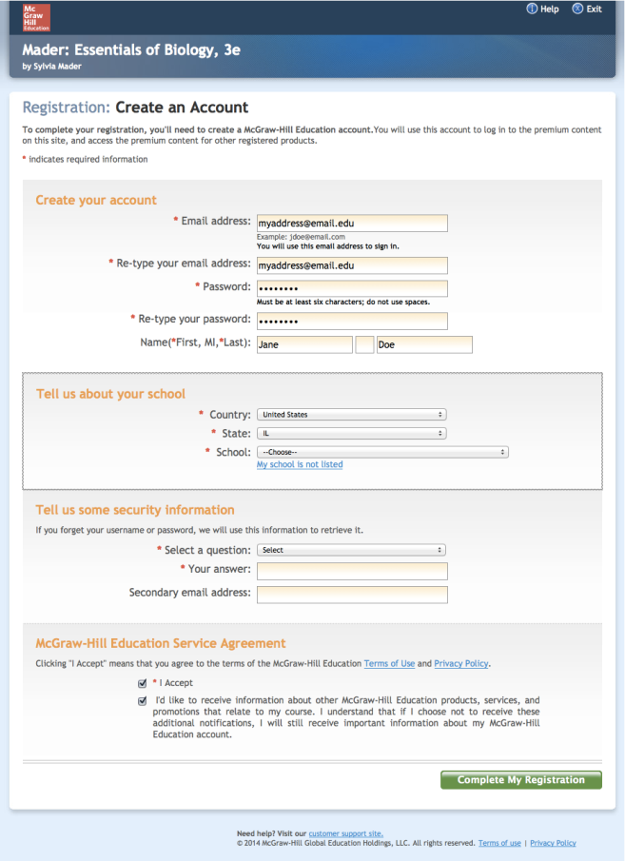
Get Started in 4 Easy Steps!
4. Complete the registration form and click “Submit”

Slide 17
The Results
YOU learn more efficiently
YOU get the help you need, when you need it
YOU learn more, and earn higher grades

Slide 18

Become a MGH Student Ambassador!
The Student Ambassador program allows individuals to:
  Learn: grow your network and gain leadership experience
  Collaborate: partner with your MHE sales team to drive digital awareness on your campus
  Build your personal brand: hone your skills in public speaking, problem solving, and creativity by interacting with faculty, students, and MHE executives
  Make an Impact: work directly with MHE to assist in product development and be part of the future of digital education
Please visit
bit.ly/mheambassadors
for more information

Slide 19

Read it Forward
For every Smartbook & ConnectPlus purchased until November 1st, McGraw-Hill Education will donate a K-12 textbook to a child in need around the world.
Find more at: www.mhereaditforward.com

Slide 20
Need Help?
Tech Support & FAQ:
Call: (800) 331-5094
Email & Chat: www.mhhe.com/support
Monday - Thursday ● 8 AM - 11 PM
Friday ● 8 AM - 6 PM
Saturday ● 10 AM - 4 PM
Sunday ● 12 PM - 11 PM
(All times Central)
Find more support at: www.connectstudentsuccess.com
NOTE: If you contact your instructor with a technical question, you will be asked to provide a case number from tech support before your concern is escalated.
Notes:
Our goal is to provide you with the service you need to get the most out of Connect. Our customer support is here to assist you with any technical issues you might be having. If you’re having trouble with anything – accessing a page, submitting an assignment, etc. -- use these resources before going to your professor. We have many people dedicated to helping you with all things technical. Keep the cards/stickers we passed out somewhere you can’t lose them, and use these resources whenever you need.
www.mhhe.com/support has a new chat functionality; You can browse through connect student success for anything else you might need; FAQs, etc.

